Slide 1
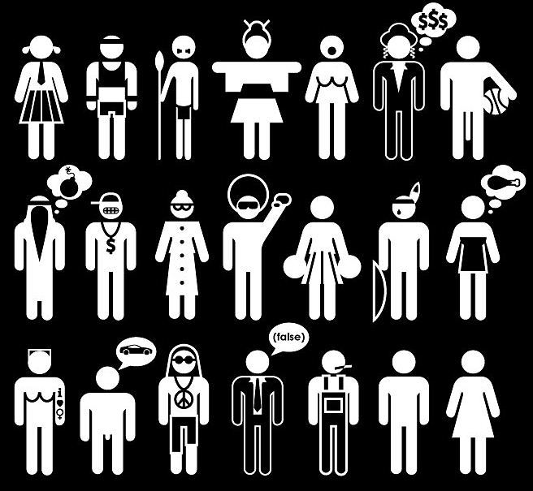
Stereotypes
Humans and categories

Slide 2
Stereotypes
Official definition of a stereotype:
“a fixed mental image of a group that is frequently applied to all its members.”
The world is complex and confusing.
We confront it by finding ways to categorize, compartmentalize, and define.

Slide 3
Stereotypes
Teachers use categories to help explain complex concepts.
For example, “There are four main categories of advertising.
Or “There are three basic philosophies of modern media ethics.”

Slide 4

Stereotypes
Researchers use categories to help define and label.
If you label something, it helps you to understand it.
For example, we can categorize millions of biological species by an extensive system of botanical classes:
Kingdom, Phylum, Class, Order, Family, Genus, Species.

Slide 5
Stereotypes
We also like to categorize human beings. Humans are complex, and so to categorize simplifies.
Most of our knowledge of the world comes from somebody else, and not our direct experience.
We can use this second-hand knowledge to build compartments.

Slide 6
Stereotypes
From those compartments, we can fit people into what we already think we know about the world—our preconceived notions.
Unfortunately, this stereotyping, while making the world simpler, also can lead to unfair treatment of others.

Slide 7
Stereotypes
Obvious stereotypes:
Sexism.
Racism.
Ethical prejudice.
Religious prejudice.
These are most discussed, and most controversial.

Slide 8
Stereotypes
But other groups also are stereotyped. In fact, most are. For example:
Fat people=slothful slobs.
Journalists=people without scruples.
Professors=absent-minded and out of touch.
Students=arrogant and lazy boozers.
Politicians=unethical and sleazy.
? Name your group.

Slide 9
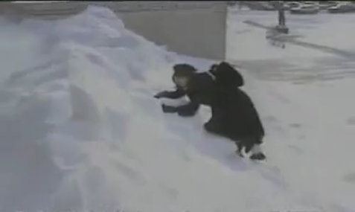
Stereotypes
Many areas of the United States, and their people, are stereotyped through the media.
In fact, one of the most common American stereotypes: Fargo, North Dakota. [http://www.youtube.com/watch?v=W6c8bYq9Ve8]

Slide 10
Stereotypes
So we can relate to the result of geographic stereotyping in the media.
But we also stereotype other countries.
The U.S. media typically has unflattering portrayals of Russia, Arab or African countries.
Their media also stereotypes the United States negatively, of course.

Slide 11
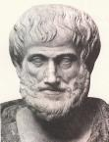
Stereotypes
Stereotyping was rampant and even more accepted throughout history.
Aristotle, the “father of virtue ethics,” defended slavery in the fourth century B.C.E.
He said slaves should be treated differently: it was nature’s intention to make the bodies of slaves more suitable for “servile labors.”

Slide 12
Stereotypes
Often people will try to defend stereotypes by finding an authority who will agree with them.
Religious Americans in the nineteenth century often defended slavery by pointing to the Bible book of Genesis, 9:25-27. Noah, upset at his son Ham, who was supposedly black, responded by cursing Ham’s son Canaan and all his offspring to be slaves for all eternity.
Genesis 9:25-27: “’Cursed be Canaan! The lowest of slaves will he be to his brothers.’ He also said, ‘Blessed be the Lord, the God of Shem! May Canaan be the slave of Shem. May God extend the territory of Japheth; may Japeth live in the tents of Shem and may Canaan be his slave.’”

Slide 13
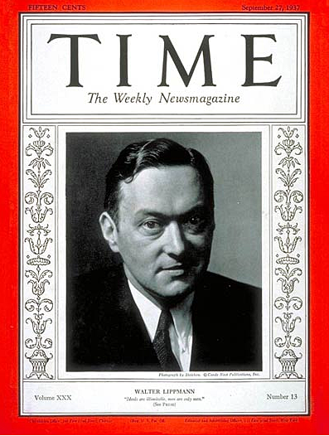
Stereotypes
But do we sometimes need stereotypes to simplify complex things? Maybe.
Walter Lippmann in 1922 defended some stereotyping.

Slide 14
Stereotypes
Lippmann observed that to see all things as new, fresh, and in detail, instead of types and generalities, is exhausting and time-consuming.
In modern life we don’t usually have time for this.
We rely, therefore, on generalities. As Lippmann noted:

Slide 15
Stereotypes
In our day-to-day interactions, “there is neither time nor opportunity for intimate acquaintance. Instead, we notice a trait which marks a well-known type, and fill in the rest of the picture by means of stereotypes we carry around in our heads.”
--Walter Lippmann

Slide 16
Stereotypes
Because we know little of the world by direct experience, we rely on others to tell us.
Especially we rely on mass media.
This seems to mean media people have an ethical responsibility to understand stereotyping versus reality.

Slide 17
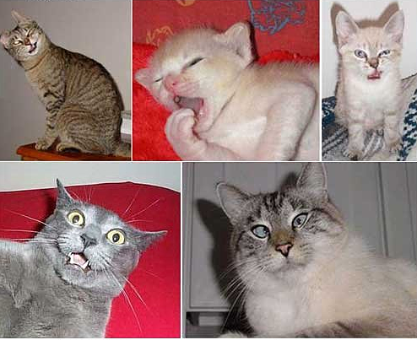
Stereotypes
The patterns of stereotyping in ourselves are hardly neutral.
They involved personal perceptions of reality.
They also involve our emotions.

Slide 18
Stereotypes
Based on that, Lippmann noted we can use a stereotype to hide behind.
With the stereotype, we will feel safe in our position regarding another group or idea.
But stereotypes aren’t always bad.

Slide 19
Stereotypes
We can use stereotypes to group things, and so better study them, as we noted.
If you group people as students, or professors, or lawyers, or politicians, or farmers—this does contain some useful information for members of each category.
They will have traits in common—although each individual can’t be reduced to these aspects alone, but will have many more traits.

Slide 20
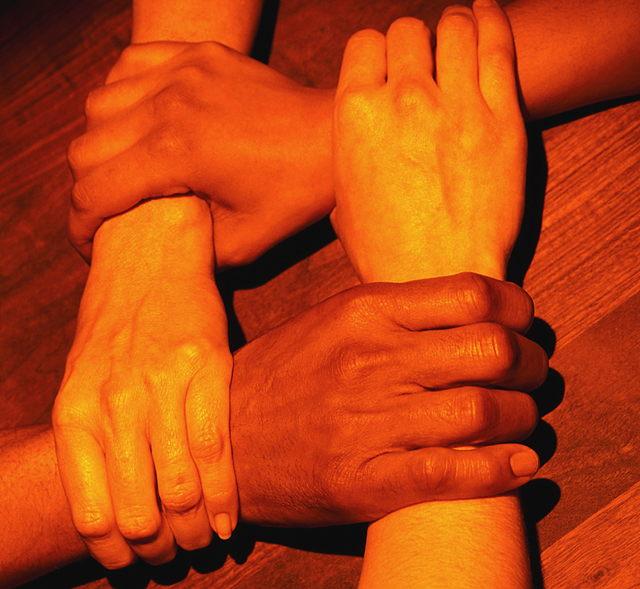
Stereotypes
Some may even have traits different from those suggested by the categories.
Nevertheless, we have to admit that stereotyping seems to work against the common belief of equality in society.

Slide 21
Stereotypes
Stereotypes can be unfair.
We don’t perceive individual differences, just groups.
If you believe people in society have the right to control of self, that is, self-determination—stereotyping takes that control away.

Slide 22
Stereotypes
Stereotypes put people in compartments they have no control over, merely because they are part of a certain group.
Putting all students, or North Dakotans, or professors, or blacks, or Muslims, into a category seems to undermine the belief in individual dignity and human worth.
Stereotypes are convenient. But they also create barriers.

Slide 23
Stereotypes
So are stereotypes lies? Not exactly.
Stereotypes do have a basis in reality.
The problem: making inaccurate judgments about another person based on the stereotype.

Slide 24
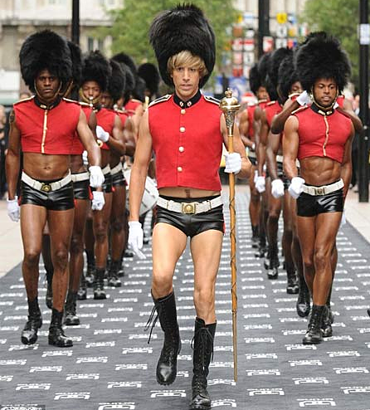
Stereotypes
For example, the media have traditionally pictured gay men as flamboyant and effeminate.
Some are. But these traits represent only a segment, not the whole group.
The image, however, helps to erect barriers between gays and the rest of society. Some critics argue such barriers are unethical.

Slide 25
Stereotypes
Which group has been most criticized for its use of stereotypes? The media.
The media need to avoid unfair stereotypes, while still emphasizing stereotypes may play legitimate roles, and may be inevitable.
Lippmann believed some stereotyping was necessary, and the media reflect this.

Slide 26
Stereotypes
Entertainment programs on television reflect stereotypes.
Television show formulas, or genres, produce stereotypical characters that an audience can relate to.
But the danger is that the TV stereotype will replace our critical judgment about people in real life.

Slide 27
Stereotypes
Three groups (to use categories) traditionally have been most identified as subject to media stereotypes:
Minorities.
Women.
Elderly.

Slide 28
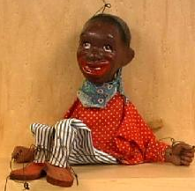
Stereotypes
For literally generations, Americans thought of black people based on the media’s stereotypical image: slow-moving and dim-witted.
Surely this stereotype is no longer prevalent—is it? At least it seems to be gone from the media.

Slide 29
Stereotypes
More recent media stereotypes of African-Americans have depicted them as welfare recipients, drug pushers, impoverished, uneducated.
This fits one segment of the population. But it ignores the large segment of middle-class black people in America.
African-Americans in the media still are less often depicted in professional roles.

Slide 30
Stereotypes
Why do such stereotypes change so slowly in the media?
One factor: management of news media by minorities is not common.
Coverage of newsworthy social problems focus on those people most likely to represent the perceived stereotypes, such as the inner city black gang members or Hispanic illegal aliens.

Slide 31
Stereotypes
Native American stereotypes are significant in North Dakota and Minnesota, represented by a high Indian population.
In the past, Indians were portrayed by Hollywood as the “savages.”
Long before that time, treating them as less than human in the press made it easier to brutalize and marginalize them as settlers expanded west.

Slide 32
Stereotypes
Stereotyping is first step toward ability to hurt or kill without guilt. It is always used during wartime:
The “Japs.”
The “Krauts.”
The “Gooks”

Slide 33
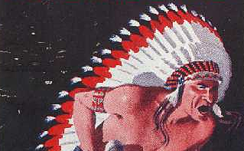
Stereotypes
The media reduced 400 Indian tribes in America to one stereotype of “brave and squaw” with “war bonnet or papoose.”
But they began to complain in the 1970s. Today media are working to overcome these obvious stereotypes.

Slide 34
Stereotypes
Advertisers also are criticized for stereotypes of Indians and others.
Advertising must rely on stereotypes, however: messages are short.
Advertisers regularly used stereotypical minorities to sell things, before minorities began to complain in the 70s.

Slide 35
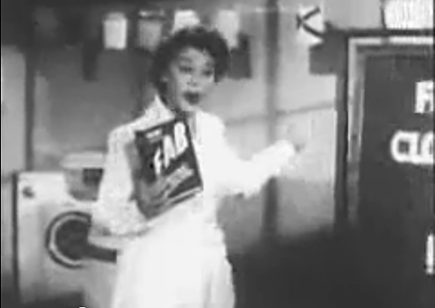
Stereotypes
Woman in particular have been stereotyped by advertisers and others.
In the 1950s they were depicted an ads as wanting to please husbands and get cleaner laundry. [http://www.youtube.com/watch?v=SOOlcVAbIEI&feature=related]

Slide 36
Stereotypes
Early television shows like “Leave It to Beaver” and “I Love Lucy” depicted stereotypical woman as either the “perfect wife” or “dumb and accident-prone.”
These famous shows were entertaining to millions. But not very accurate depictions of women.
In 1970s programming, women became more assertive and self-reliant, as in “Mary Tyler Moore” and “Golden Girls.”

Slide 37
Stereotypes
Nevertheless, much advertising today still depicts women as obsessed with beauty, sex appeal, and interested mostly in being appealing to men.
This advertising does probably reflect a segment of that group.
But do advertisers and the media have some ethical responsibility to promote more positive images, or to simply reflect prevailing social norms?

Slide 38
Stereotypes
We live in a youth-oriented culture. Negative portrayals of elderly people are common:
Infirm, stubborn, childlike, forgetful, crotchety and ridiculous.
The media do not seem to be altering their commonly distorted views of elderly, however, nor do they seem to face as much criticism of them.

Slide 39
Stereotypes
The disabled traditionally have been invisible in the media.
When they have been portrayed, it has been as helpless or pitiful.
Probably this is changing, but disabled people still face common stereotypes in the media.

Slide 40
Stereotypes
How do ethics philosophers consider stereotyping?
If they believe that the individual person must be respected, then stereotypes clearly undermine that respect.
Kant would ask us to make a decision universal. To universalize racism and prejudice by stereotype would probably not be considered acceptable to Kant.

Slide 41
Stereotypes
The Golden Mean might call for diversity in media presentations, not letting one segment represent the whole.
The teleologists would say the motive doesn’t matter, but results do. They might criticize someone like Norman Lear. Who is Norman Lear?

Slide 42
Stereotypes
Consider that deontologists like Kant would look at the motivation of the maker.
In the 1970s Norman Lear created Archie Bunker, a white bigot that represented all the common prejudices of American culture.
He used stereotypes to confront the country’s racist attitudes. [http://www.youtube.com/watch?v=O_UBgkFHm8o]

Slide 43
Stereotypes
This was Lear’s motive—but some viewers did not recognize the satire, and so prejudice was reinforced and sanitized by television.
On the one hand, we as media professionals seem to have an ethical responsibility to avoid the really degrading and prejudicial stereotypes.
But what is degrading?

Slide 44
Stereotypes
On the other hand, society does have a cultural heritage. Many classic works contain stereotypical characters.
The stereotypes in Huckleberry Finn are racist. Should that book be banned?
But to ban that would really not reflect the freedoms of democracy.

Slide 45
Stereotypes
Perhaps instead of banning past stereotypes in shows like “I Love Lucy” or famous novels, we should instead work to overcome stereotypes in new work.
And we might consider stereotypes in other parts of our society.
For example, consider Halloween costumes. When we dress a child as a hobo, or Indian, or witch, are we perpetuating stereotypes?

Slide 46
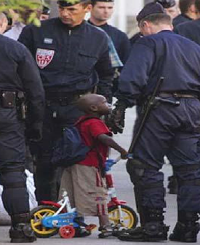
Stereotypes
Can you think of a stereotype in your own life, or one from the media? Why was it used? Does it need to be used?

